Slide 1

CSE 412: Artificial Intelligence
Topic – 4: Informed Search and Exploration
Department of Computer Science and Engineering
Daffodil International University

Slide 2

Topic Contents
Informed (Heuristic) Search Strategies
Heuristic Functions
Local Search Algorithms and Optimization
Problems
    Hill-climbing search
    Simulated annealing search
    Local beam search
    Genetic algorithms

Slide 3
Informed Search = Heuristic Search
Informed search uses problem-specific knowledge (heuristics) to guide the search towards the goal faster than uninformed search.

Slide 4
Informed Search (Two Main Branches)
Under the umbrella of Informed Search
  Heuristic Tree Search
  Heuristic Local Search
Informed search includes both goal-directed tree searches and optimization-oriented local searches, all using heuristics to improve efficiency.

Slide 5
Heuristic Tree Search
Path-finding / Goal search
  Greedy Best-First Search
  A*
  Recursive Best-First Search (RBFS)
  Memory-bounded A*
Application: route planning, robot navigation, puzzle solving

Slide 6
Heuristic Local Search
Optimization (Find best solution)
  Hill-climbing
  Simulated annealing
  Local Beam search
  Genetic algorithms
Application: optimization, scheduling, machine learning hyperparameter tuning, game AI, design problems.

Slide 7

Best-First Search
Node is selected for expansion based on an evaluation function f(n)
Evaluation function estimates distance to the goal
Choose node which appears best
Implementation:
  fringe is a priority queue sorted in ascending order of f-values

Slide 8
A Heuristic Function h(n)
Dictionary definition: “A rule of thumb, simplification, or educated guess that reduces or limits the search for solutions in domains that are difficult and poorly understood”
For best-first search:
  h(n) = estimated cost of the cheapest path from node n to goal node

Slide 9
A Heuristic Function h(n)
A rule of thumb:
  A general guideline or practical approach, not an exact rule
  Example: If you are lost, follow the river downstream to find civilization
Simplification:
  Heuristics simplify decision-making by reducing complex problems into manageable steps
  Example: When grocery shopping, choose items with fewer ingredients to eat healthier

Slide 10
A Heuristic Function h(n)
Educated guess:
  A guess based on prior knowledge and experience rather than a precise calculation
  Example: If a computer is running slow, restarting it might fix the issue
Reduces or limits the search for solutions:
  Instead of analyzing every possible option, heuristics help you focus on likely solutions
  Example: Instead of checking every key on a keychain, you first try the one that looks the most used

Slide 11
A Heuristic Function h(n)
Domains that are difficult and poorly understood:
  Heuristics are useful when there’s no clear formula for solving a problem
  Example: Investors often use heuristics like “buy low, sell high” in stock markets because predicting exact prices is difficult

Slide 12
A Heuristic Function h(n)
A heuristic is a quick, practical way to solve problems when time, information or understanding is limited
It’s not always perfect, but it often works well enough

Slide 13

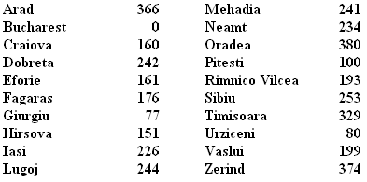
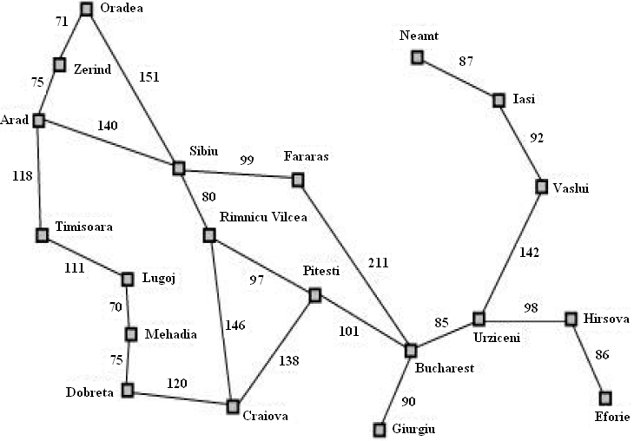
Romania with Step Costs in Km
h_{SLD} = straight-line distance heuristic
h_{SLD} cannot be computed from the problem description itself
In greedy best-first search f(n)=h(n)
  Expand node that is closest to goal

Slide 14
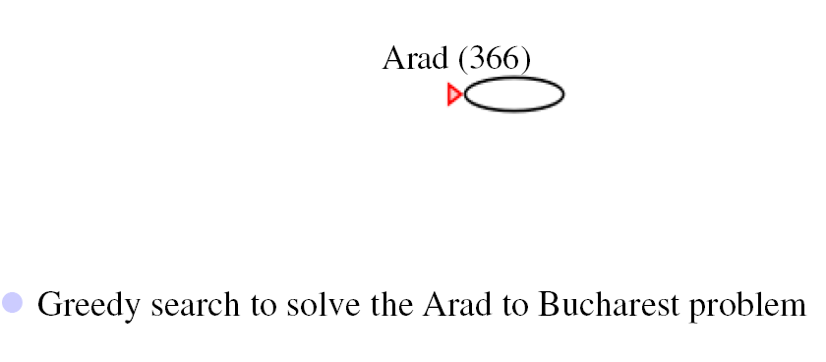
Greedy Search: Example

Slide 15
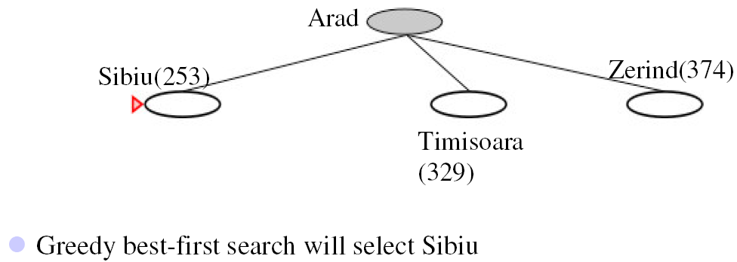
Greedy Search: Example

Slide 16
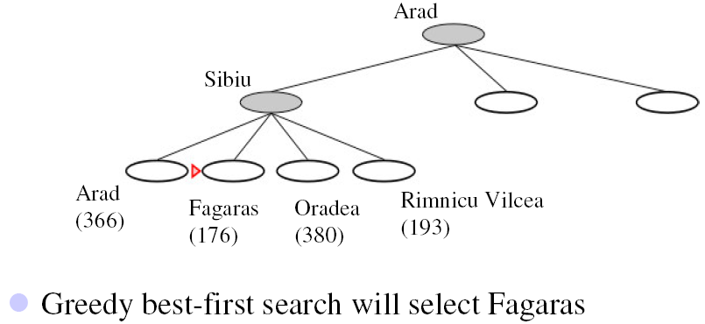
Greedy Search: Example

Slide 17
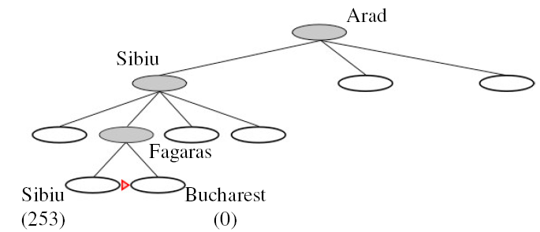
Greedy Search: Example
Goal reached
  For this example no node is expanded that is not on the solution path
  Arad -> Sibiu -> Fagaras -> Bucharest
  = 450
  But not optimal (see Arad, Sibiu, Rimnicu Vilcea, Pitesti)
Arad → Sibiu → Rimnicu Vilcea → Pitesti → Bucharest
140 + 80 + 97 + 101 = 418

Slide 18
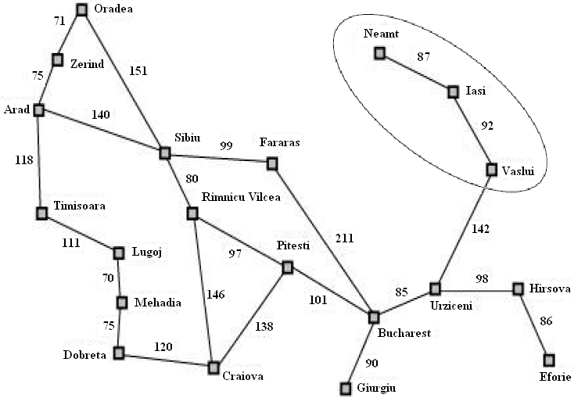
Greedy Search: Evaluation
Complete or optimal: no
  Minimizing h(n) can result in false starts, e.g. Iasi to Fagaras
  Check on repeated states

Slide 19
Greedy Search: Evaluation
Not guaranteed to find the best (optimal) solution and may not always find a solution at all (not complete).
Not Complete: because GBFS might get stuck in loops or fail to reach the goal
Not Optimal: because it chooses the next step based only on the heuristic h(n), without considering the total cost g(n).

Slide 20
Greedy Search: Evaluation
Example: If you only follow the shortest visible path on a maze without checking dead ends, you might get stuck or take a longer path.

Slide 21
Greedy Search: Evaluation
“Minimizing h(n) can result in false starts”, e.g., Iasi to Fagaras
Here, h(n) is the heuristic function (estimated cost to the goal).
"False starts" happen because GBFS chooses the most promising-looking step (smallest h(n)) without considering past costs.
A Search (which considers both past cost g(n) and heuristic h(n)) avoids this problem.

Slide 22
Greedy Search: Evaluation
“Check on repeated states”
  This means we should avoid revisiting already-explored states to prevent infinite loops and redundant calculations

Slide 23
Greedy Search: Evaluation
Time and space complexity:
  In the worst case all the nodes in the search tree are generated: O(b^{m} )
  (m is maximum depth of search tree and b is branching factor)
  But: choice of a good heuristic can give dramatic improvement

Slide 24
A* Search
Best-known form of best-first search
Idea: avoid expanding paths that are already expensive
Evaluation function f(n)= g(n) + h(n)
  g(n): the cost (so far) to reach the node
  h(n): estimated cost to get from the node to the goal
  f(n): estimated total cost of path through n to goal
A* search is both complete and optimal if h(n) satisfies certain conditions

Slide 25
A* Search
A* search is optimal if h(n) is an admissible heuristic
A heuristic is admissible if it never overestimates the cost to reach the goal
  h(n) ≤ h*(n) where h*(n) is the true cost from n
Admissible heuristics are optimistic about the cost of solving the problem
e.g. h_{SLD}(n) never overestimates the actual road distance

Slide 26
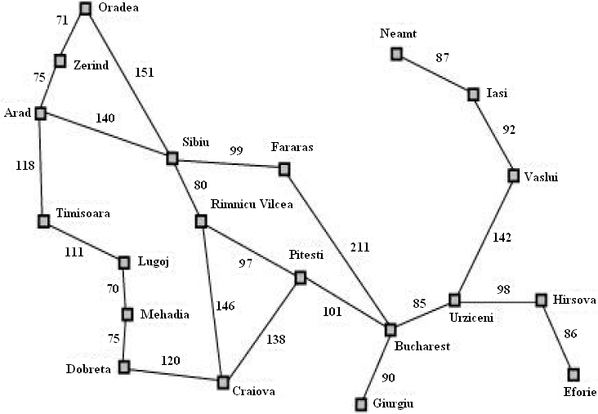
Romania Example

Slide 27

A* Search: Example

Slide 28
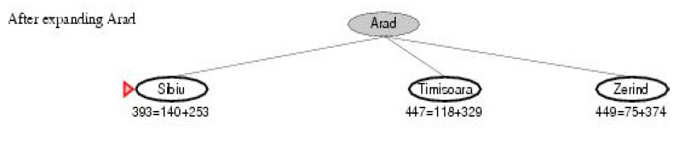
A* Search: Example

Slide 29
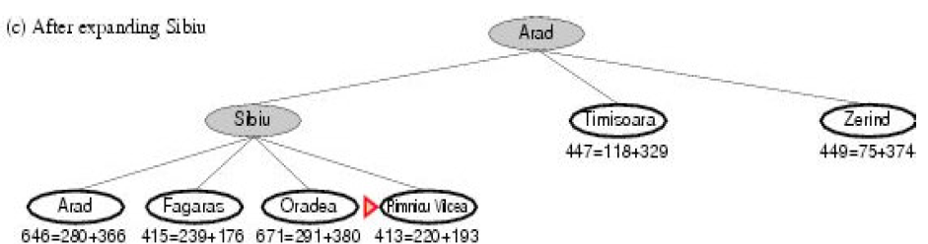
A* Search: Example

Slide 30
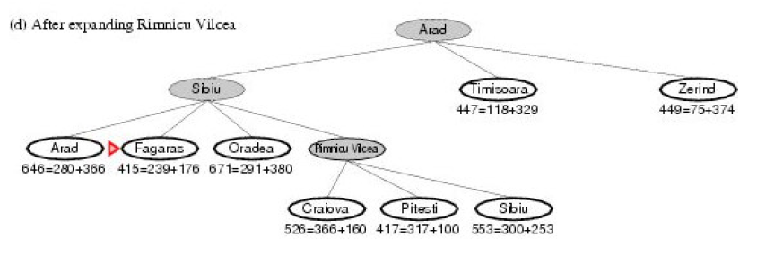
A* Search: Example

Slide 31
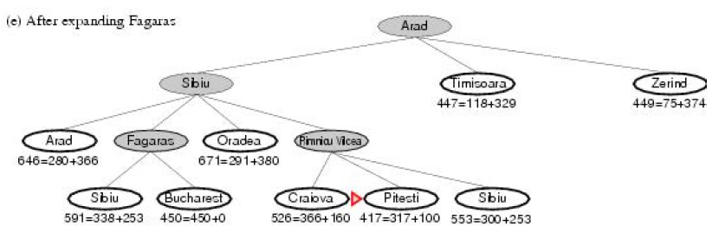
A* Search: Example

Slide 32
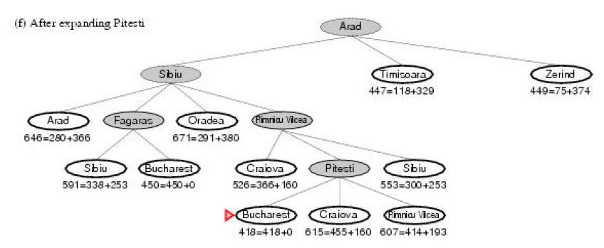
A* Search: Example

Slide 33

Optimality of A*
Suppose a suboptimal goal node G₂ appears on the fringe and let the cost of the optimal solution be C*.
Since G₂ is suboptimal and
h(G₂) = 0 (true for any goal node),
we know that f(G₂) = g(G₂) + h(G₂) = g(G₂) > C*
Now consider a fringe node n that is on an optimal solution path.
If h(n) does not overestimate the cost of completing the solution path,
then we know that f(n) = g(n) + h(n) ≤ C*
Since f(n) ≤ C* < f(G₂), G₂ will not be expanded and A* search must return an optimal solution.

Slide 34
A* Search: Evaluation
Complete: yes
  Unless there are infinitely many nodes with f < f(G)
Optimal: yes
  A* is also optimally efficient for any given h(n). That is, no other optimal algorithm is guaranteed to expand fewer nodes than A*.

Slide 35
A* Search: Evaluation
Time complexity:
  number of nodes expanded is still exponential in length of solution
Space complexity:
  All generated nodes are kept in memory
  A* usually runs out of space before running out of time

Slide 36
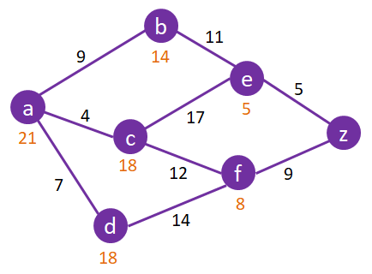
Apply the steps of the A* Search algorithm to find the shortest path from A to Z using the above graph

Slide 37
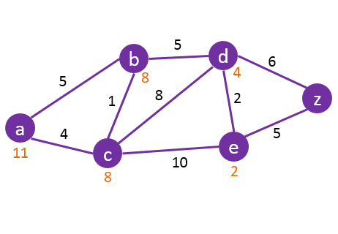
Apply the steps of the A* Search algorithm to find the shortest path from A to Z using the above graph

Slide 38
Heuristic Functions
Let us see two heuristics for a problem.

Slide 39
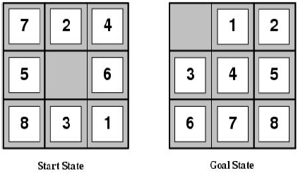
Example: 8-puzzle
States: location of each tile plus blank
Initial state: Any state can be initial
Actions: Move blank {Left, Right, Up, Down}
Goal test: Check whether goal configuration is reached
Path cost: Number of actions to reach goal

Slide 40
Example: 8-puzzle
For 8-puzzle problem:
  h₁ = number of tiles out of place. In the example h₁= 8
  h₂ = total Manhattan distance of errant pieces. In the example
  h₂ = 3+1+2+2+2+3+3+2 = 18

Slide 41
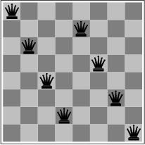

Local Search Algorithms and Optimization Problems
Previously: systematic exploration of search space
  Path to goal is solution to problem
for some problem classes, it is sufficient to find a solution
  the path to the solution is not relevant, e.g. 8-queens
Different algorithms can be used
  Local search
memory requirements can be dramatically relaxed by modifying the current state
  all previous states can be discarded
  since only information about the current state is kept, such methods are called local

Slide 42
Local Search Algorithms and Optimization Problems
Local search = use single current state and move to neighboring states.
Advantages:
  Use very little memory
  Find often reasonable solutions in large or infinite state spaces.
Are also useful for pure optimization problems.
  Find best state according to some objective function.
  e.g. survival of the fittest as a metaphor for optimization.

Slide 43

Local Search Algorithms and Optimization Problems

Slide 44
Hill-Climbing Search
continually moves uphill
  increasing value of the evaluation function
  gradient descent search is a variation that moves downhill
is a loop that continuously moves in the direction of increasing value - that is, uphill.
  It terminates when a peak is reached.

Slide 45
Hill-Climbing Search
Hill-climbing does not look ahead of the immediate neighbors of the current state.
Hill-climbing chooses randomly among the set of best successors, if there is more than one.
Hill-climbing is also called greedy local search
Hill-climbing is a very simple strategy with low space requirements
  stores only the state and its evaluation, no search tree

Slide 46
Hill-Climbing Example
8-queens problem (complete-state formulation).
Successor function: move a single queen to another square in the same column.
Heuristic function h(n): the number of pairs of queens that are attacking each other (directly or indirectly).

Slide 47
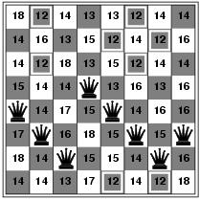

Hill-Climbing Example
(a)
(b)
(a) An 8-queens state with heuristic cost estimate h = 17, showing the value of h for each possible successor obtained by moving a queen within its column. The best moves are marked.
(b) A local minimum in the 8-queens state space; the state has h = 1 but every successor has a higher cost.

Slide 48
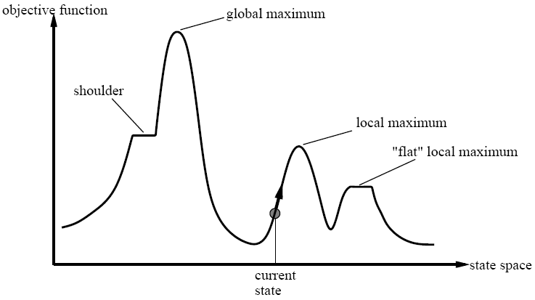

Slide 49
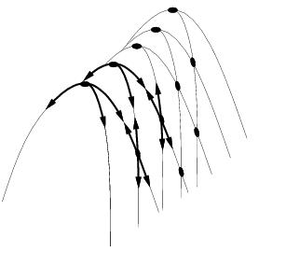
Drawbacks
Ridge = sequence of local maxima difficult for greedy algorithms to navigate
Plateaux = an area of the state space where the evaluation function is flat.
Gets stuck 86% of the time.

Slide 50
Hill-Climbing Search
problems
  local maxima
    algorithm can’t go higher, but is not at a satisfactory solution
  plateau
    area where the evaluation function is flat
  ridges
    search may oscillate slowly

Slide 51
Escaping Local Optima
HC gets stuck at local maxima limiting
the quality of the solution found.
Two ways to modify HC:
  Change the choice of neighbor
  Change the criteria to accept a neighbor
For example:
  choose neighbor randomly
  Accept worse neighbor with some probability p

Slide 52
Escaping Local Optima
Modified HC can escape local maxima but:
  chance of making a bad move is the same
  at the beginning of the search as at the end
  magnitude of improvement or lack of is ignored
How can HC address these concerns?
  fixed probability p that bad move is accepted
  can be replaced with a probability
  that decreases as the search proceeds
  now as the search progresses,
  the chances of taking a bad move reduces

Slide 53

Hill-Climbing Search
function HILL-CLIMBING( problem) return a state that is a local maximum
input: problem, a problem
local variables: current, a node.
neighbor, a node.
current ← MAKE-NODE(INITIAL-STATE[problem])
loop do
neighbor ← a highest valued successor of current
if VALUE [neighbor] ≤ VALUE[current] then return STATE[current]
current ← neighbor

Slide 54
Hill-Climbing Variations
Stochastic hill-climbing
  Random selection among the uphill moves.
  The selection probability can vary with the steepness of the uphill move.
First-choice hill-climbing
  implements stochastic hill climbing by generating successors randomly until a better one is found.
Random-restart hill-climbing
  Tries to avoid getting stuck in local maxima.

Slide 55
Simulated Annealing
Escape local maxima by allowing “bad” moves.
  Idea: but gradually decrease their size and frequency.
Origin; metallurgical annealing
Bouncing ball analogy:
  Shaking hard (= high temperature).
  Shaking less (= lower the temperature).
If T decreases slowly enough, best state is reached.
Applied for VLSI layout, airline scheduling, etc.

Slide 56
Simulated Annealing
function SIMULATED-ANNEALING( problem, schedule) return a solution state
input: problem, a problem
schedule, a mapping from time to temperature
local variables: current, a node.
next, a node.
T, a “temperature” controlling the probability of downward steps
current ← MAKE-NODE(INITIAL-STATE[problem])
for t ← 1 to ∞ do
T ← schedule[t]
if T = 0 then return current
next ← a randomly selected successor of current
∆E ← VALUE[next] - VALUE[current]
if ∆E > 0 then current ← next
else current ← next only with probability e^{∆E /T}

Slide 57
Local Beam Search
Keep track of k states instead of one
  Initially: k random states
  Next: determine all successors of k states
  If any of successors is goal → finished
  Else select k best from successors and repeat.
Major difference with random-restart search
  Information is shared among k search threads.
Can suffer from lack of diversity.
  Stochastic variant: choose k successors at proportionally to state success.

Slide 58
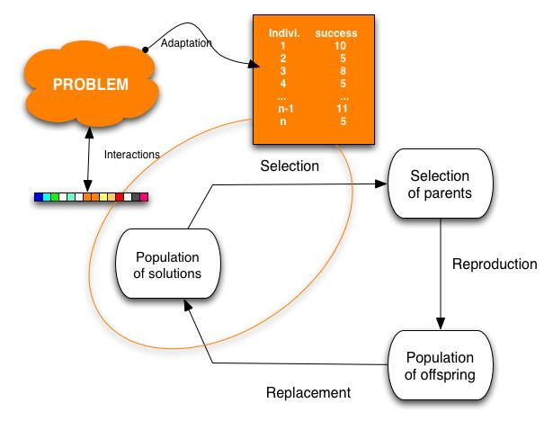
Genetic Algorithms
Variant of local beam search with sexual recombination.

Slide 59
Why is GA a Variant of Local Beam Search
Feature | Local Beam Search | Genetic Algorithm
Multiple states | Yes (k current best) | Yes (population)
Successor generation | From current neighbors | From crossover of parents
Selection | Top-k successors | Fitness-based selection of parents
Diversity mechanism | Limited (select best k) | Yes — via mutation + crossover
Information sharing | No (each state evolves alone) | Yes (via recombination between solutions)
Inspired by | Heuristic search | Evolution / biology

Slide 60
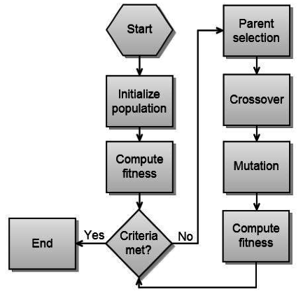
Genetic Algorithm Workflow
https://images.app.goo.gl/e5NgtpAdr5dh69NE6

Slide 61
Genetic Algorithms
GAs begin with a set of k randomly generated states, called the population.
Each state, or individual, is represented as a string over a finite alphabet—most commonly, a string of 0s and 1s.
For example, an 8-queens state must specify the positions of 8 queens, each in a column of 8 squares, and so requires 8 x log₂ 8 = 24 bits.
Alternatively, the state could be represented as 8 digits, each in the range from 1 to 8.
Figure 4.6(a) shows a population of four 8-digit strings representing 8-queens states.

Slide 62


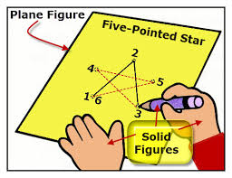
Genetic Algorithms
Figure 4.6: The three major operations in genetic algorithm. The initial population in (a) is ranked by the fitness function in (b), resulting in pairs for mating in (c). They produce offspring in (d), which are subject to mutation in (e).

Slide 63

Genetic Algorithms
The 8-queens states involved in this reproduction step are shown in Figure 4.7.
Figure 4.7: The 8-queens states corresponding to the first two parents in Figure 4.6(c) and the first offspring in Figure 4.6(d).

Slide 64
Genetic Algorithms
The production of the next generation of states is shown in Figure 4.6(b)–(e).
In (b), each state is rated by the objective function, or (in GA terminology) the fitness function.
A fitness function should return higher values for better states, so, for the 8-queens problem we use the number of nonattacking pairs of queens, which has a value of 28 for a solution.
The values of the four states are 24, 23, 20, and 11.
In this particular variant of the genetic algorithm, the probability of being chosen for reproducing is directly proportional to the fitness score, and the percentages are shown next to the raw scores.

Slide 65
Genetic Algorithms
In (c), two pairs are selected at random for reproduction, in accordance with the probabilities in (b).
Notice that one individual is selected twice and one not at all.
For each pair to be mated, a crossover point is chosen randomly from the positions in the string.
In Figure 4.6, the crossover points are after the third digit in the first pair and after the fifth digit in the second pair.
In (d), the offspring themselves are created by crossing over the parent strings at the crossover point.
For example, the first child of the first pair gets the first three digits from the first parent and the remaining digits from the second parent, whereas the second child gets the first three digits from the second parent and the rest from the first parent.

Slide 66
Genetic Algorithms
The 8-queens states involved in this reproduction step are shown in Figure 4.7.
Figure 4.7: The 8-queens states corresponding to the first two parents in Figure 4.6(c) and the first offspring in Figure 4.6(d).

Slide 67
Genetic Algorithms
The example shows that when two parent states are quite different, the crossover operation can produce a state that is a long way from either parent state.
It is often the case that the population is quite diverse early on in the process, so crossover (like simulated annealing) frequently takes large steps in the state space early in the search process and smaller steps later on when must individuals are quite similar.

Slide 68
Genetic Algorithms
Finally, in (e), each location is subject to random mutation with a small independent probability.
One digit was mutated in the first, third, and fourth offspring.
In the 8-queens problem, this corresponds to choosing a queen at random and moving it to a random square in its column.

Slide 69
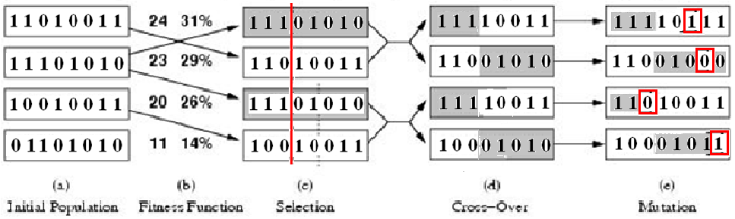
Genetic Algorithms
Figure: A genetic algorithm. The algorithm is the same as the one diagrammed in the figure in slide no. 45, with one variation: in this more popular version, each mating of two parents produces only one offspring, not two.

Slide 70
Genetic Algorithms
function GENETIC_ALGORITHM( population, FITNESS-FN) return an individual
input: population, a set of individuals
FITNESS-FN, a function which determines the quality of the individual
repeat
new_population ← empty set
loop for i from 1 to SIZE(population) do
x ← RANDOM_SELECTION(population, FITNESS_FN) y ← RANDOM_SELECTION(population, FITNESS_FN)
child ← REPRODUCE(x,y)
if (small random probability) then child ← MUTATE(child )
add child to new_population
population ← new_population
until some individual is fit enough or enough time has elapsed
return the best individual

